Slide 1

May 16 Videoconference
Arnie Schneider
Alan Flury
Scheller College of Business

Slide 2
MGT8803 Business Fundamentals for Analytics Video Conference Call #2 Announcements
Financial Accounting Homework will open on May 21 and is due on May 29. Remember you can use outside resources and can collaborate with other students but cannot share actual answers. Any homework related posts that contain your work should be marked private.
This week to keep on pace you will need to wrap up Financial Accounting topics 3 and 4.
Good activity in the forum so far. Continue to use the forum to communicate with other students and the instructors regarding course material. A number of the questions asked in the forum will be discussed on the call tonight.

Slide 3

MGT8803 Business Fundamentals for Analytics
Videoconference Call #2 Financial Accounting Topics 1 and 2
Agenda
Focus on Topics 1 and 2
Overview of Financial Statements
Current Assets
Questions from the Forum
Example Problems

Slide 4
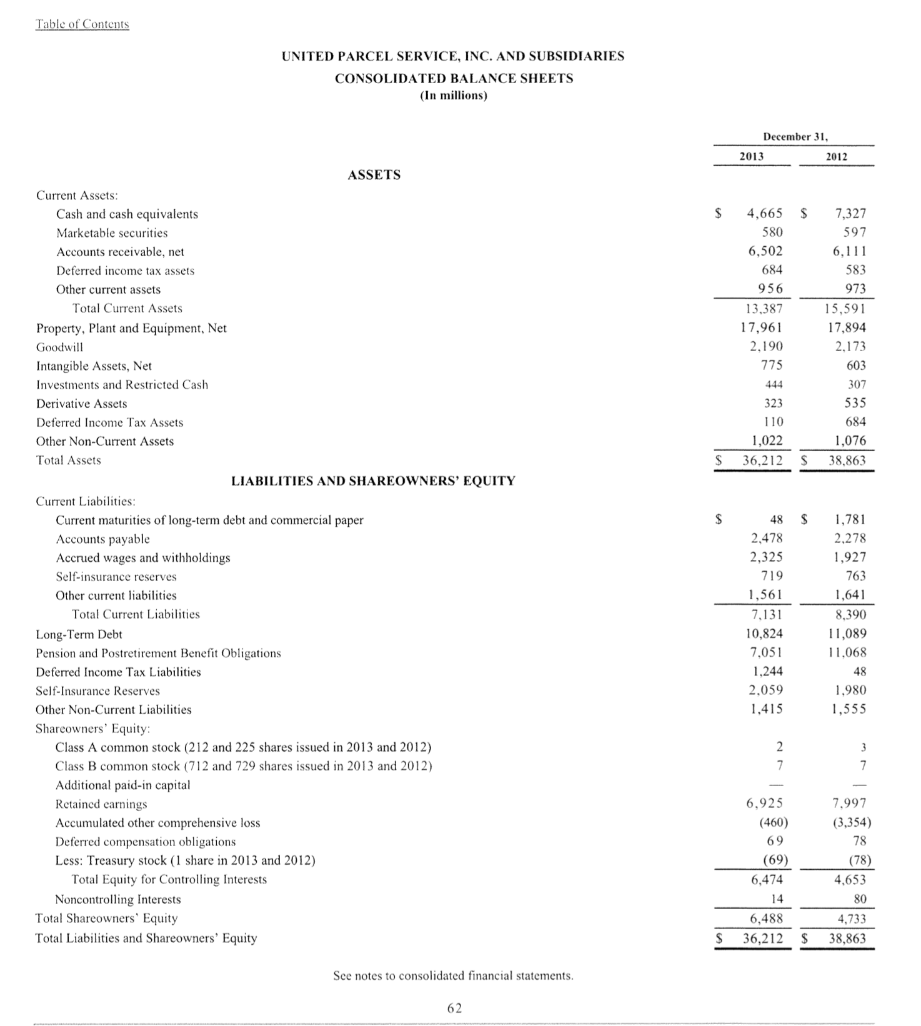
MGT8803 Business Fundamentals for Analytics Financial Accounting Overview
Balance Sheet
What is a Balance Sheet
A balance sheet reports a company's assets, liabilities and shareholders' equity at a specific point in time, and provides a basis for computing rates of return and evaluating its capital structure. It is a financial statement that provides a snapshot of what a company owns and owes, as well as the amount invested by shareholders.
A Balance Sheet Must balance:
Assets = Liabilities + Shareholders Equity
Virtually all accounting transactions effect the Balance Sheet in some way.

Slide 5
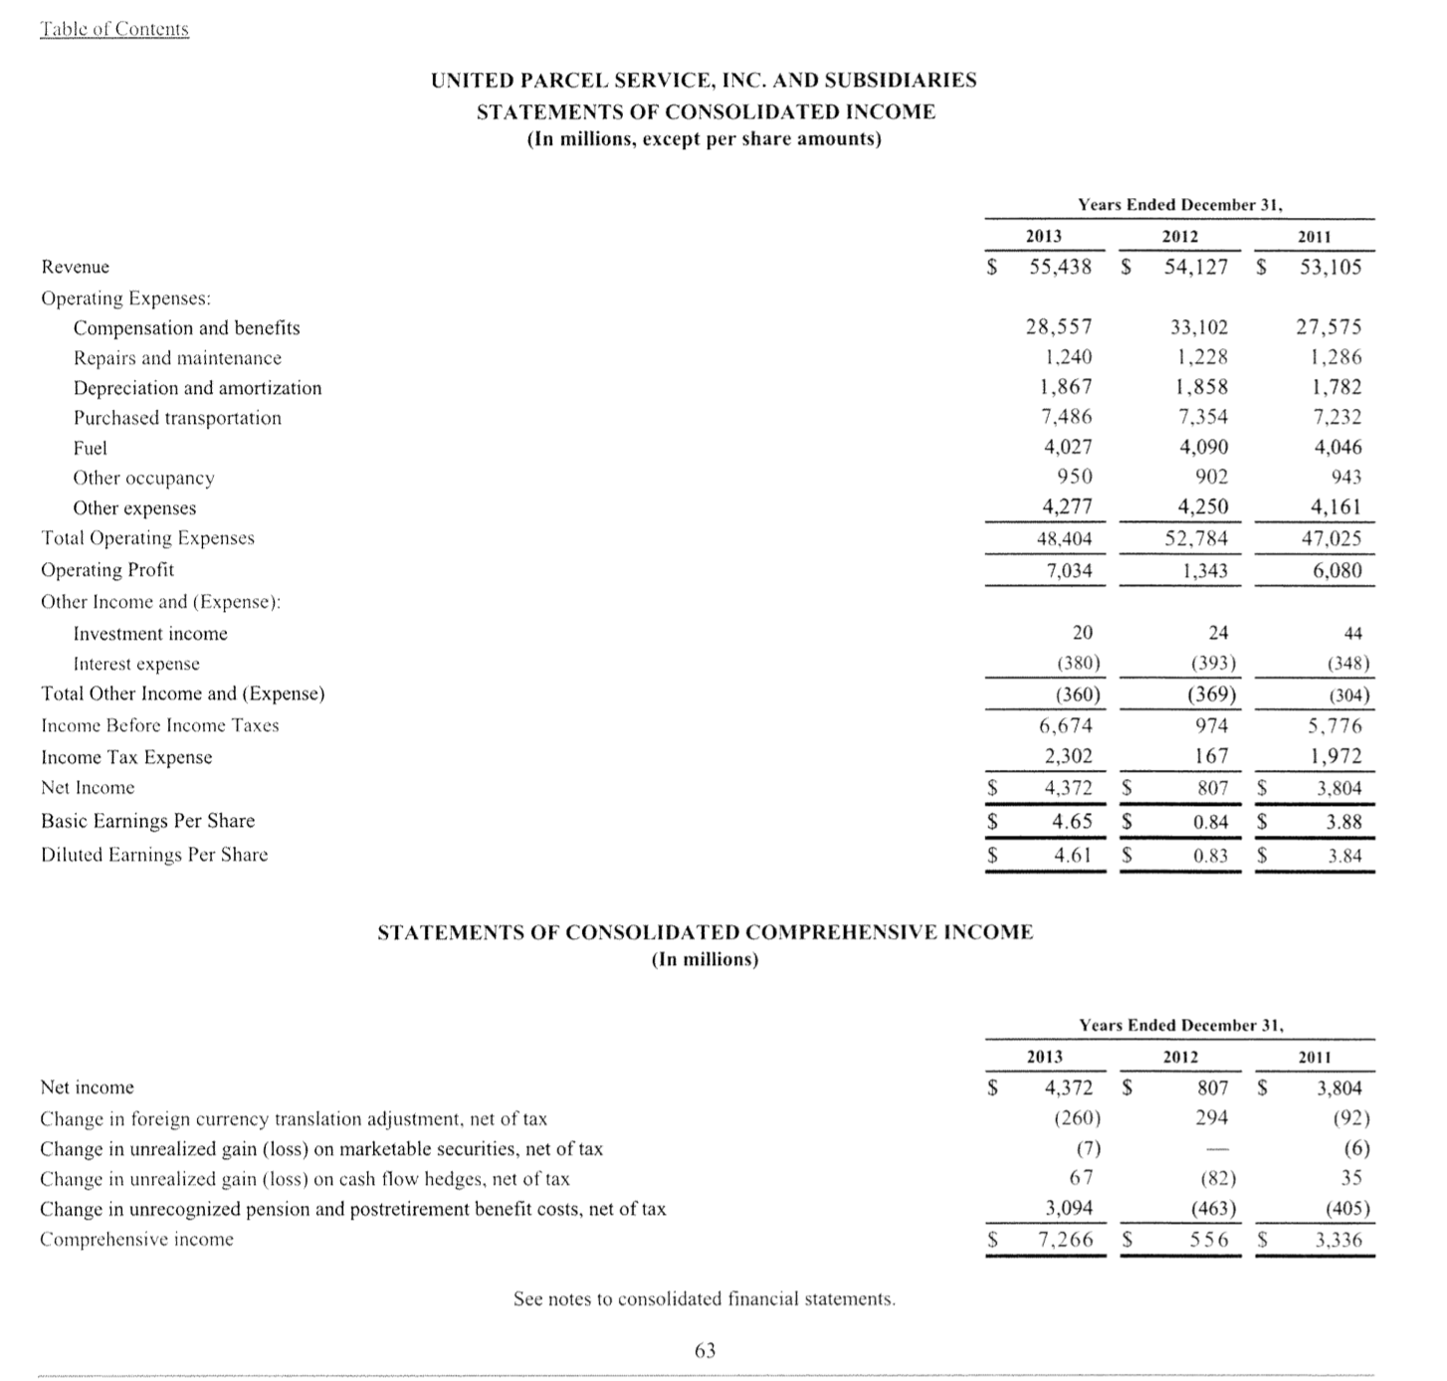
MGT8803 Business Fundamentals for Analytics Financial Accounting Overview
Income Statement
What is an Income Statement
An income statement is a financial statement that reports a company’s financial performance over a specific accounting period. Financial performance is assessed by giving a summary of how the business incurs its revenues and expenses through both operating and non-operating activities. It also shows the net profit or loss incurred over a specific accounting period.
Income Statements are often prepared to allow easy comparisons to prior periods’ financial performance. Management and analysts will use income statement comparisons to determine positive and negative trends in operating performance

Slide 6
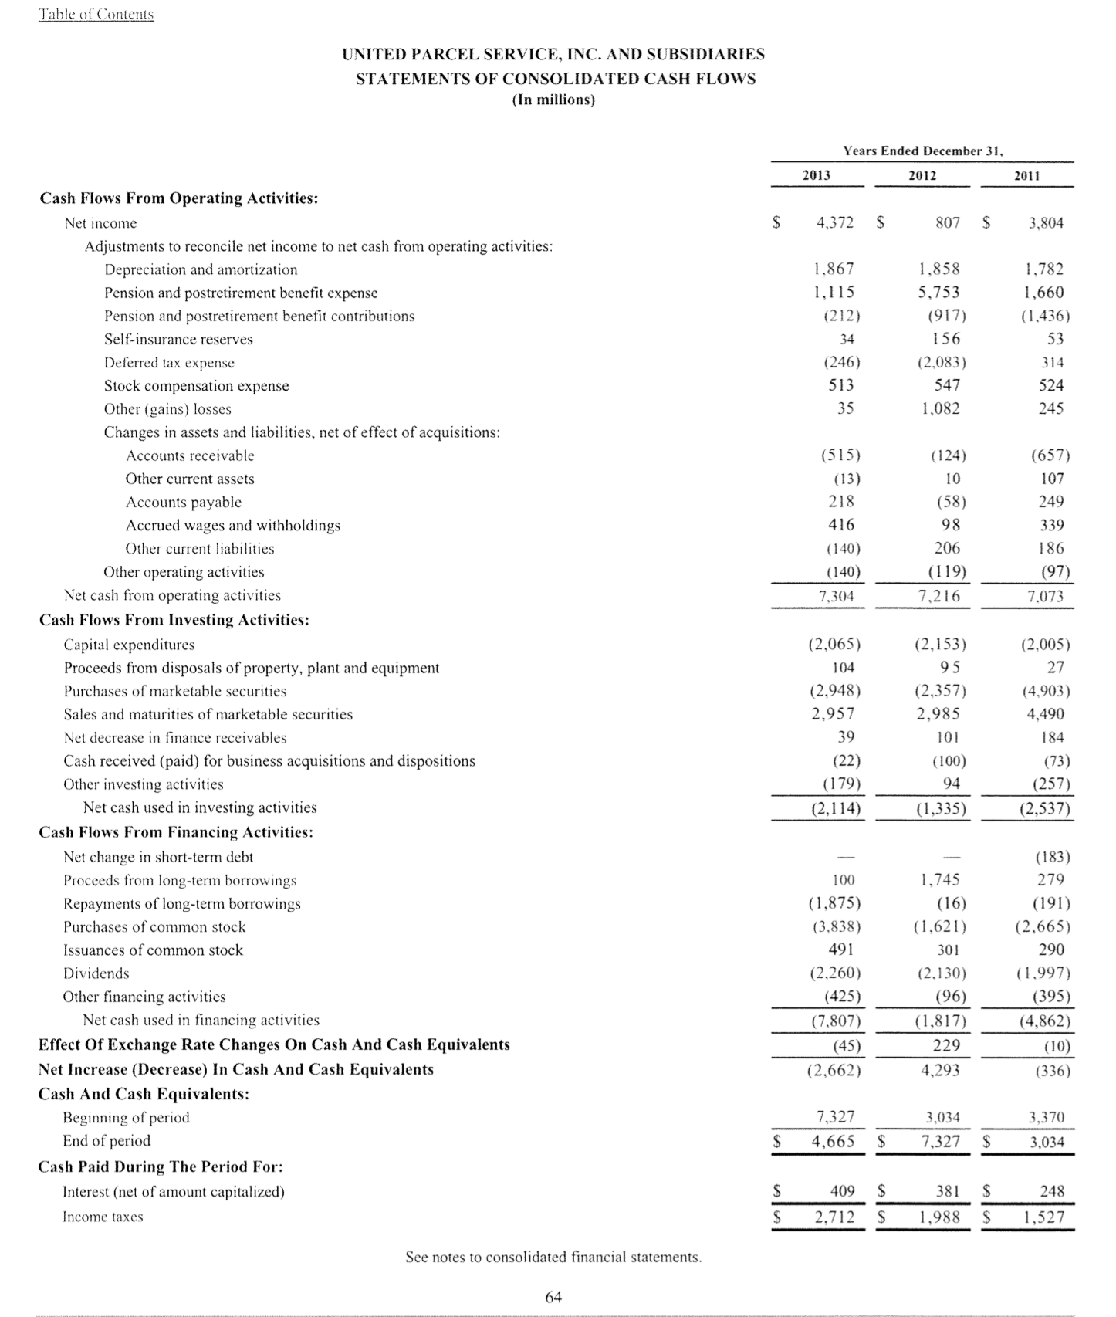
MGT8803 Business Fundamentals for Analytics Financial Accounting Overview
Statement of Cash Flows
What Is A Cash Flow Statement?
The statement of cash flow is a financial statement that summarizes the amount of cash and cash equivalents entering and leaving a company. The cash flow statement measures how well a company manages its cash position, meaning how well the company generates cash to pay it's debt obligations and fund it's operating expenses.
The cash flow statement covers a period of time, usually the same period of time covered by the Income Statement
Cash flows are typically classified as operating activities, investing activities, and financing activities

Slide 7
MGT8803 Business Fundamentals for Analytics Videoconference Call #2
Questions from the Forum
What's the difference between "factoring" and "discounting"? Is there any difference in terms of calculation or it's just different wording? And then in the example in the video, it says "discounted at the bank with recourse". I assume here it means that Co. A sold the receivables to the bank and the money will still go into the sales but with a disclosure. Am I understanding this right? Also, is the company only allowed to sell the receivable to the bank? Can any other company be the third party?
In the videos for lesson 2, Dr. Schneider says the following about valuing assets... "For decision relevance, we would want to use sales value." Does this mean that, for people making decisions based on the balance sheet, it is best to base their decisions on the "sales value" of the asset? Would the company want to use that number because it makes the company appear more valuable? Is sales value typically higher than adjusted historical costs?
Per the instruction video, EFTs should be subtracted from the book balance to arrive at the correct balance. I don't think this is correct in practice and in real life. If a company has a proper internal control over financial reporting and treasury operation, all EFTs need to be authorized by someone at the company prior to the actual transfers and as a results, they would have been recorded. Unrecognized EFTs are the ones that raise suspicions and need to be investigated during bank recon. EFT deposits (into the company by customers) are under a separate category called bank collection.

Slide 8
MGT8803 Business Fundamentals for Analytics Videoconference Call #2
Other Questions (Previous Semesters)
When reconciling the company books to the banks records, both sides of the have +/- errors. I am assuming after you add and subtract all the known differences, if you still see a difference in value - this is how you identify a potential error. My question is, how do you know if it is a company and/or bank error(s)? How do you determine which of your two numbers is the correct 'z’?
If a company uses the weighted average method for inventory costing for tax purposes can it use LIFO, FIFO, or weighted average for financial reporting purposes?
FIFO vs. LIFO Accounting. What situations favor one method over the other. Can companies use both methods concurrently

Slide 9
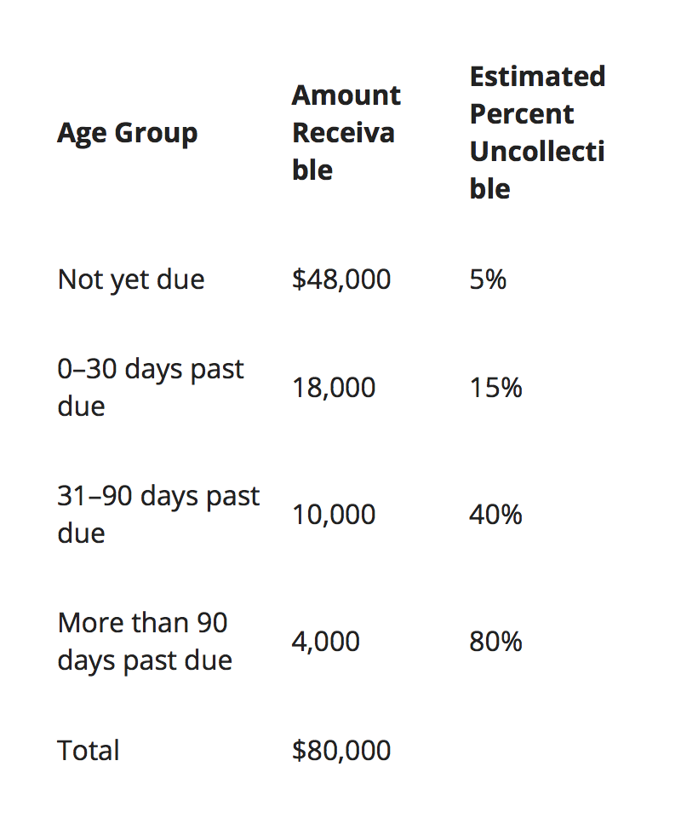
MGT8803 Business Fundamentals for Analytics Video Conference Call #2 Calculation of Bad Debt Expense
Calculation of Ending Allowance
For Bad Debts:
($48,000*.05) + ($18,000*.15) +( $10,000*.4) + ($4,000*.8)
= $12,300
Bad Debt Expense = Ending Allowance – Beginning Allowance
(In this problem the beginning allowance is given as $1,100)
$12,300 - $1,100 = $11,200
The Direct Method
Using the Direct Method uncollectible accounts are specifically written off as they become uncollectible. This occurs upon receipt of a bankruptcy notice or after a specified period of time. Although the direct write-off method ensures the exact amount of uncollectible accounts is recorded, it fails to uphold the matching principle in which the expense is not always recognized in the same period as the revenue. (from Investopedia)

Slide 10
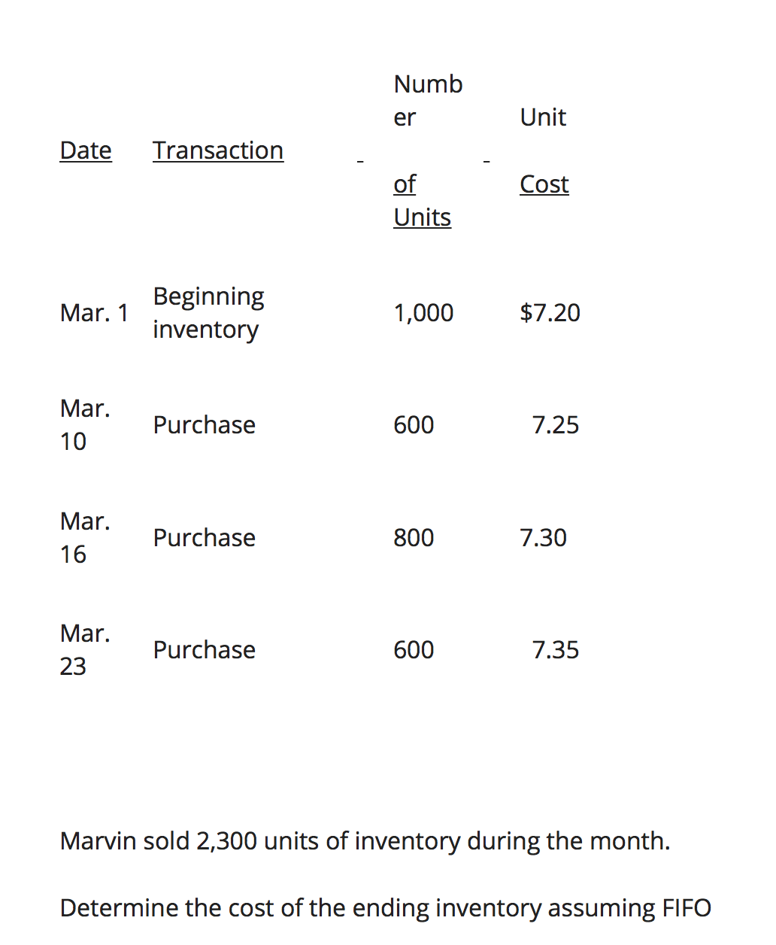
MGT8803 Business Fundamentals for Analytics Video Conference Call #2 LIFO vs. FIFO
Cost of Goods Sold –LIFO
The total number of units in inventory (available) for the was 1000+600+800+600 = 3000. Since 2300 units were sold, 700 units remain in the inventory at the end of the month. For LIFO purposes the last 2300 in were the first 2300 out. So working backwards, COGS (LIFO) = (600*$7.35)+(800*$7.30)+(600*$7.25)+300*$7.20) = $16,760
Remaining inventory = 700*$7.20= $5040.
Cost Goods Sold – FIFO
Same number of units available for sale (3000). 2300 units sold. For FIFO we work going forward in time, COGS (FIFO) =
(1000*$7.20)+(600*$7.25)+(700*$7.30) = $16,660
Remaining Inventory = (100*$7.30)+(600*$7.35)= $5,140
Cost of Goods Sold – Average Costs
(1000*$7.20)+(600*$7.25)+(800*$7.30)+(600*$7.35) = $21,800
$21,800/3000 = $7.266667
$7.26667*2300 = $16,713
$7.26667*700 = $5,087

Slide 11
MGT8803 Business Fundamentals for Analytics Video Conference Call #2 Bank Reconciliation
Peterson Company’s books shows a cash balance of $7,850 on May 31. May cash receipts of $1,250, included in the book balance, are placed in the night depository at the bank on May 31 and processed by the bank on June 1. The bank statement dated May 31 shows an NSF check for $200 and a service fee of $50. The bank processes all checks written by the company by May 31 and lists them on the bank statement, except for one check totaling $1,640. The bank statement shows a balance of $7,990 on May 31. Prepare a bank reconciliation to calculate the correct ending balance of cash on May 31
Company’s Books
Unadjusted Book $7,850
+Bank Collections
-NSF Checks 200
+Interest Earned
+Bank Service Charges 50
-EFT Payments
+EFT Receipts
+ or - errors
Adjusted Book $7,600
Bank Statement
Unadjusted Bank $7,990
+Deposits in Transit $1,250
+Cash on Hand
- Outstanding checks $1,640
+ or - errors
Adjusted Bank $7,600

Slide 12
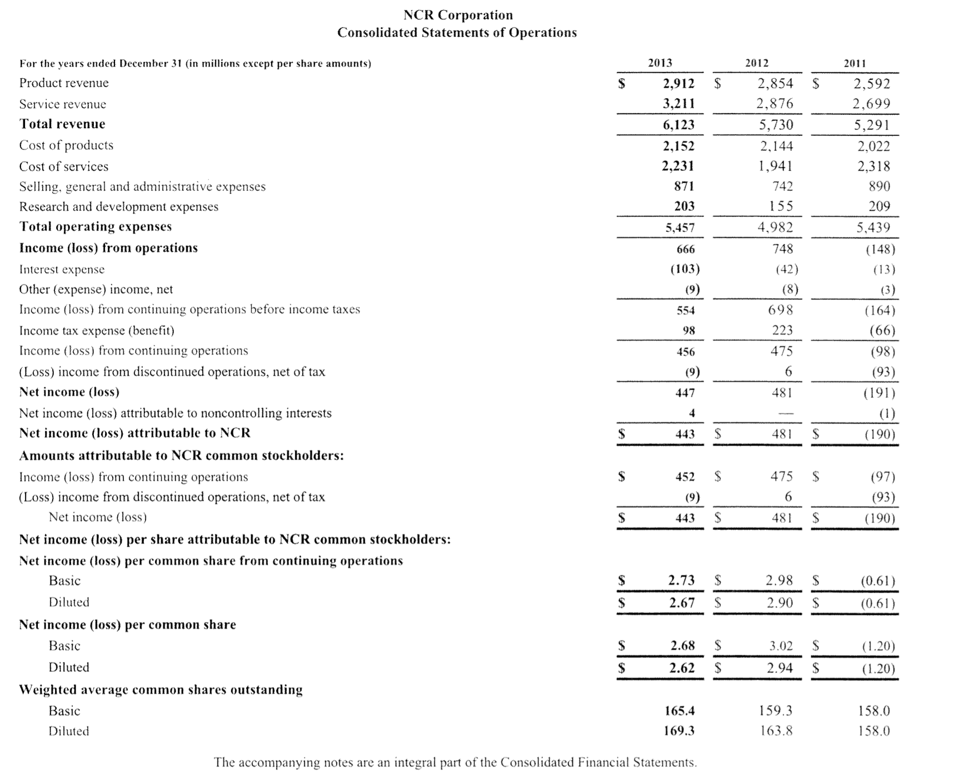
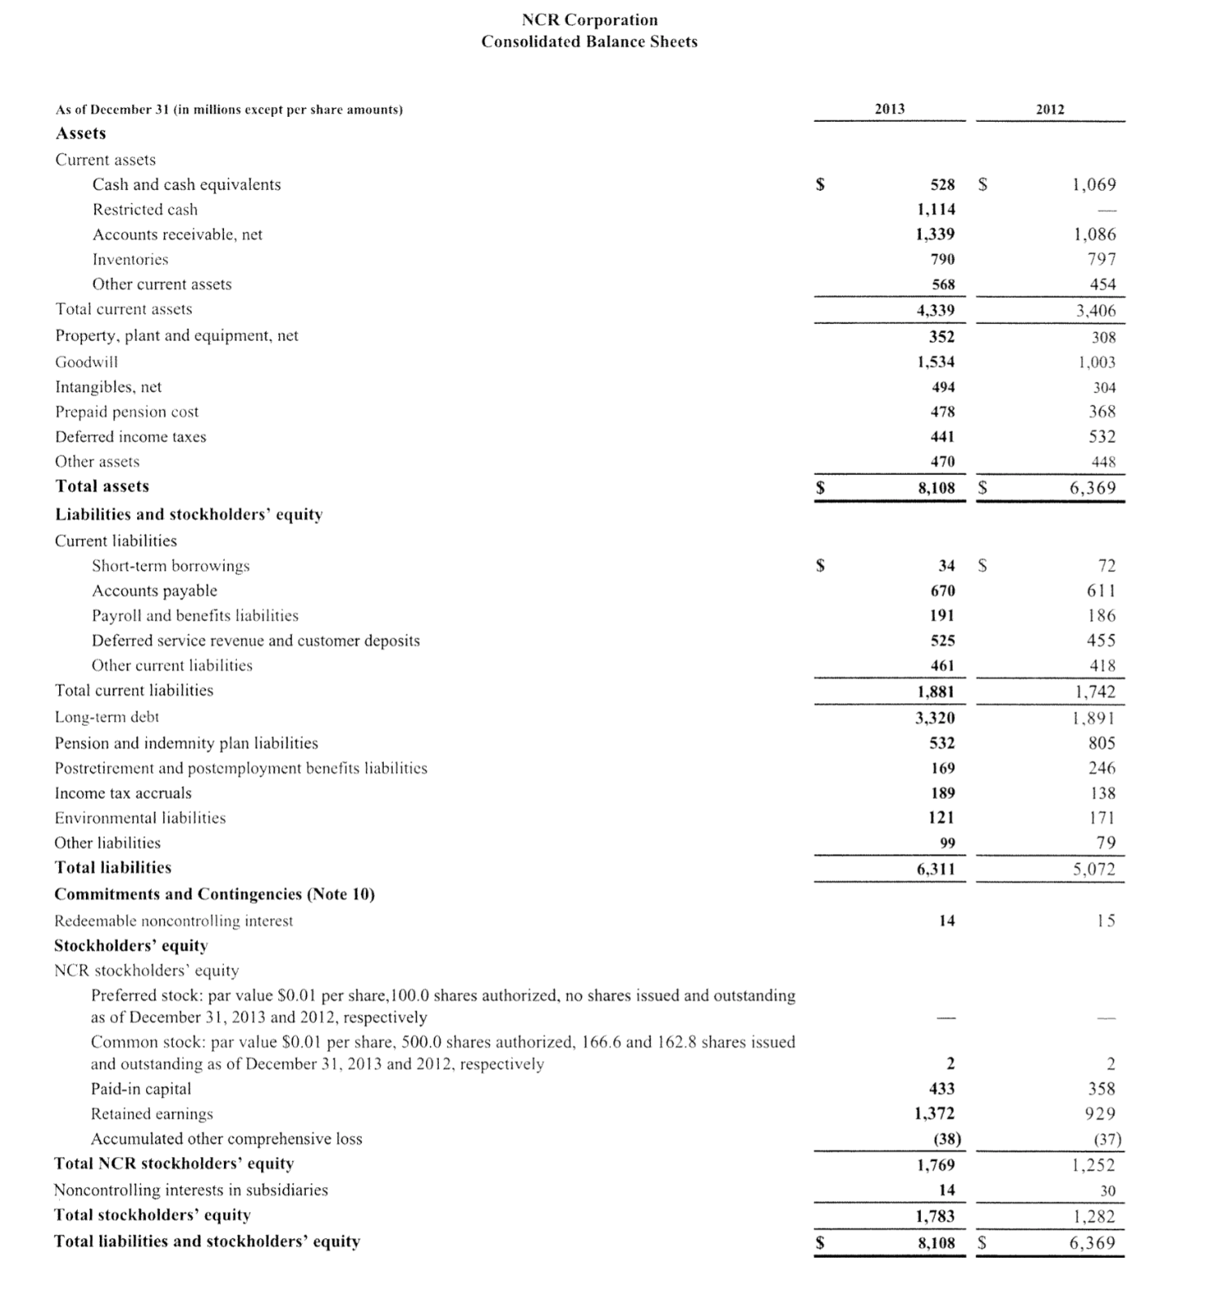
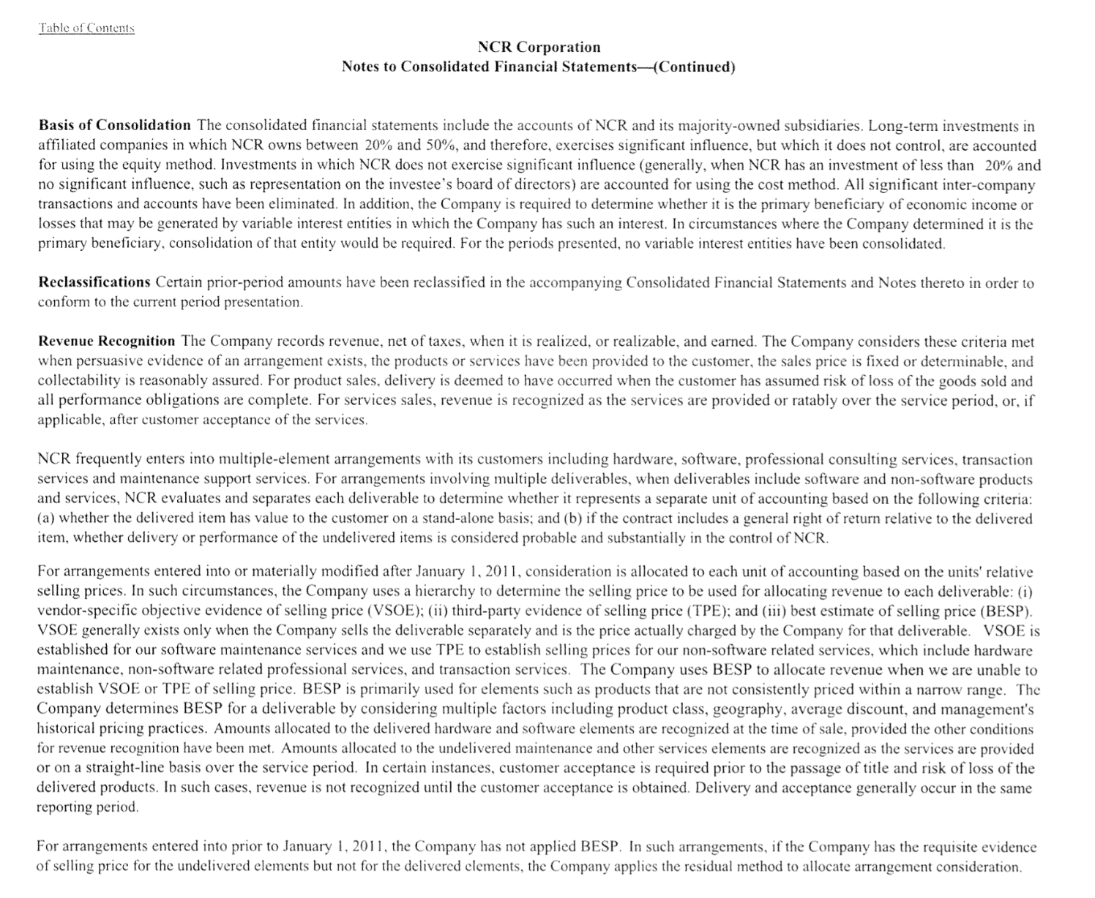
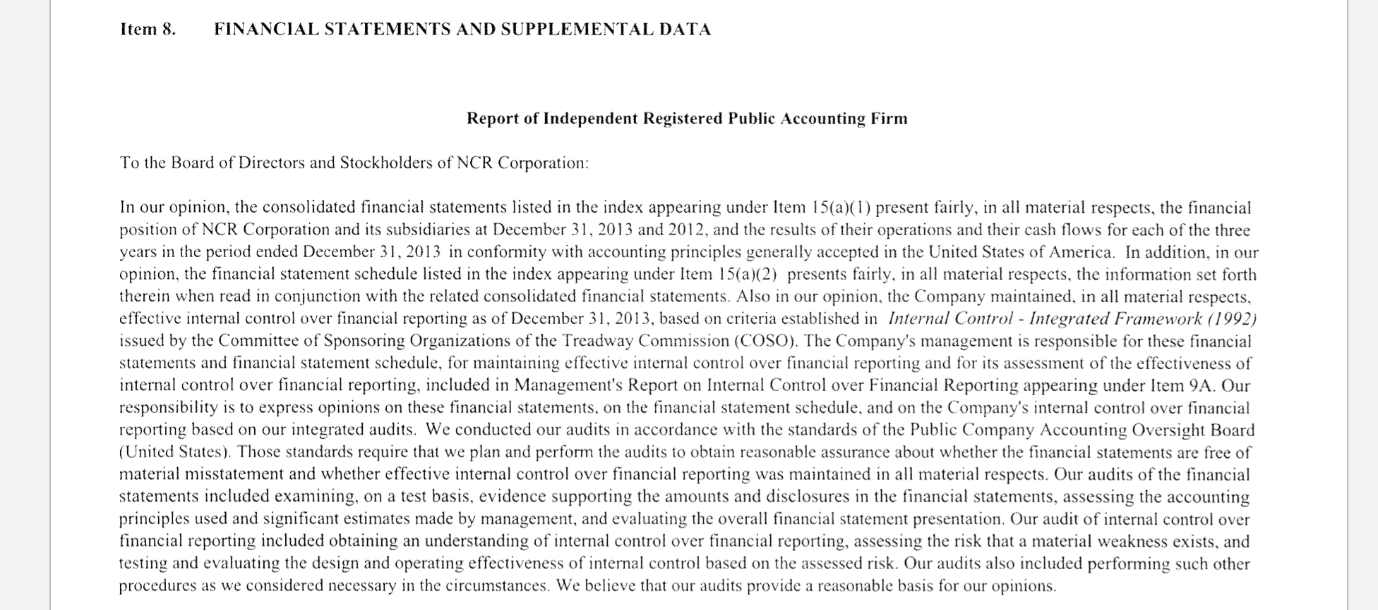
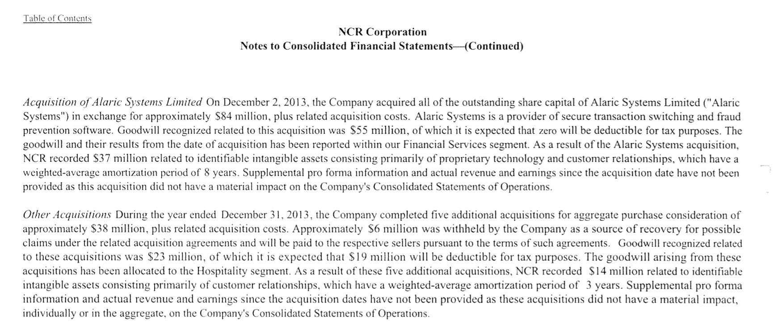
Videoconference Call #2
Topic 1 Assignment and Class Exercise
(This slide should be viewed in slide show mode)
What type of audit opinion has PricewaterhouseCoopers given for NCR’s financial statements?
What calculation was made to obtain the NCR 2013 Diluted Net Income per Common Share of $2.62?
What is the total amount of non-current assets (NCR) at Dec. 31, 2013?
What is the amount of dividends declared in 2013 by NCR?
If NCR has made an arrangement to deliver goods to a customer and has done so, what other criteria are necessary before NCR will recognize revenue?
What assumption relates to the last sentence of the first paragraph on page 69 of NCR’s financials?

Slide 13
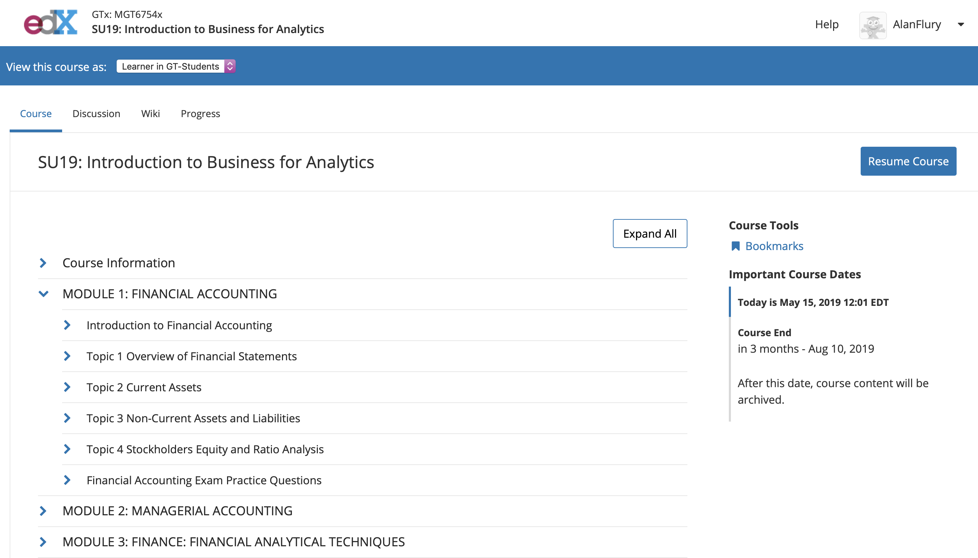
MGT8803 Business Fundamentals for Analytics Videoconference Call#2 This Week

